Slide 1
Chapter 10: Memory Interface – Part I

Slide 2
10–1 MEMORY DEVICES
Before attempting to interface memory to the microprocessor, it is essential to understand the operation of memory components.
In this section, we explain functions of the
four common types of memory:
  read-only memory (ROM)
  Flash memory (EEPROM)
  Static random access memory (SRAM)
  dynamic random access memory (DRAM)

Slide 3
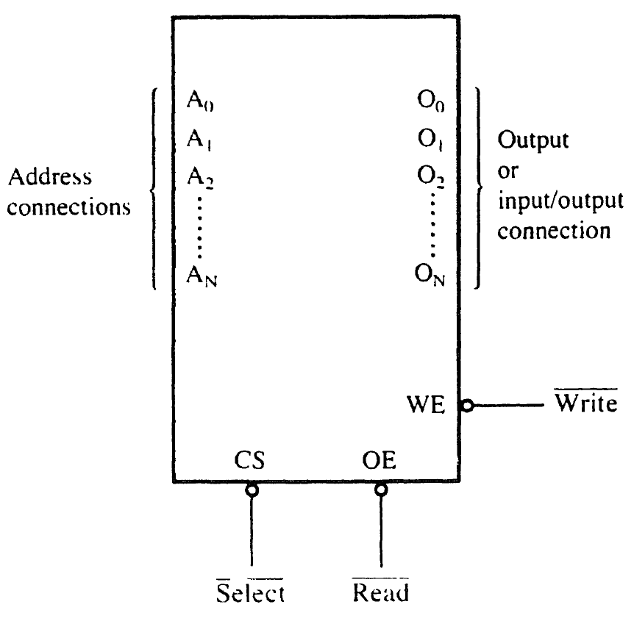
Figure 10–1 A pseudomemory component illustrating the address, data, and control connections.
Memory Pin Connections
  address inputs
  data outputs or input/outputs
  some type of selection input
  at least one control input to select a read or write operation

Slide 4
Address Connections
Memory devices have address inputs to
select a memory location within the device.
Almost always labeled from A₀, the least significant address input, to A_{n}
  where subscript n can be any value
  always labeled as one less than total number
  of address pins
A memory device with 10 address pins has
its address pins labeled from A₀ to A₉.

Slide 5
The number of address pins on a memory device is determined by the number of memory locations found within it.
Today, common memory devices have between 1K (1024) to 1G (1,073,741,824) memory locations.
  with 4G and larger devices on the horizon
A 1K memory device has 10 address pins.
  therefore, 10 address inputs are required to
  select any of its 1024 memory locations

Slide 6
It takes a 10-bit binary number to select any single location on a 1024-location device.
  1024 different combinations
  if a device has 11 address connections, it
  has 2048 (2K) internal memory locations
The number of memory locations can be extrapolated from the number of pins.

Slide 7
Data Connections
All memory devices have a set of data
outputs or input/outputs.
  today, many devices have bidirectional
  common I/O pins
  data connections are points at which data are entered for storage or extracted for reading
Data pins on memory devices are labeled D₀ through D₇ for an 8-bit-wide memory device.

Slide 8
An 8-bit-wide memory device is often called a byte-wide memory.
  most devices are currently 8 bits wide,
  some are 16 bits, 4 bits, or just 1 bit wide
Catalog listings of memory devices often refer to memory locations times bits per location.
  a memory device with 1K memory locations
  and 8 bits in each location is often listed as
  a 1K × 8 by the manufacturer
Memory devices are often classified according to total bit capacity.

Slide 9
Selection Connections
Each memory device has an input that selects or enables the memory device.
  sometimes more than one
This type of input is most often called a chip select (G2A) chip enable (CE) or simply select (S) input.
RAM memory generally has at least one or input, and ROM has at least one
If more than one CE connection is present,
all must be activated to read or write data.

Slide 10
Control Connections
All memory devices have some form of control input or inputs.
  ROM usually has one control input, while RAM often has one or two control inputs
Control input often found on ROM is the output enable or gate connection, which allows data flow from output data pins.
The OE connection enables and disables a set of three-state buffers located in the device and must be active to read data.

Slide 11
RAM has either one or two control inputs.
  if one control input, it is often called R/W
If the RAM has two control inputs, they are usually labeled WE (or W ), and OE (or G ).
  write enable must be active to perform memory write, and OE active to perform a memory read
  when the two controls are present, they must never both be active at the same time
If both inputs are inactive, data are neither written nor read.
  the connections are at their high-impedance state

Slide 12
ROM Memory
Read-only memory (ROM) permanently stores programs/data resident to the system.
  and must not change when power disconnected
Often called nonvolatile memory, because its contents do not change even if power is disconnected.
A device we call a ROM is purchased in mass quantities from a manufacturer.
  programmed during fabrication at the factory

Slide 13
The EPROM (erasable programmable read-only memory) is commonly used when software must be changed often.
  or when low demand makes ROM uneconomical
  for ROM to be practical at least 10,000 devices
  must be sold to recoup factory charges
An EPROM is programmed in the field on a device called an EPROM programmer.
Also erasable if exposed to high-intensity ultraviolet light.
  depending on the type of EPROM

Slide 14
PROM memory devices are also available, although they are not as common today.
The PROM (programmable read-only memory) is also programmed in the field by burning open tiny NI-chrome or silicon oxide fuses.
Once it is programmed, it cannot be erased.

Slide 15
A newer type of read-mostly memory
(RMM) is called the flash memory.
  also often called an EEPROM (electrically erasable programmable ROM)
  EAROM (electrically alterable ROM)
  or a NOVRAM (nonvolatile RAM)
Electrically erasable in the system, but they require more time to erase than normal RAM.
The flash memory device is used to store setup information for systems such as the video card in the computer.

Slide 16
Flash has all but replaced the EPROM in most computer systems for the BIOS.
  some systems contain a password stored
  in the flash memory device
Flash memory has its biggest impact in memory cards for digital cameras and memory in MP3 audio players.
Figure 10–2 illustrates the 2716 EPROM, which is representative of most common EPROMs.

Slide 17
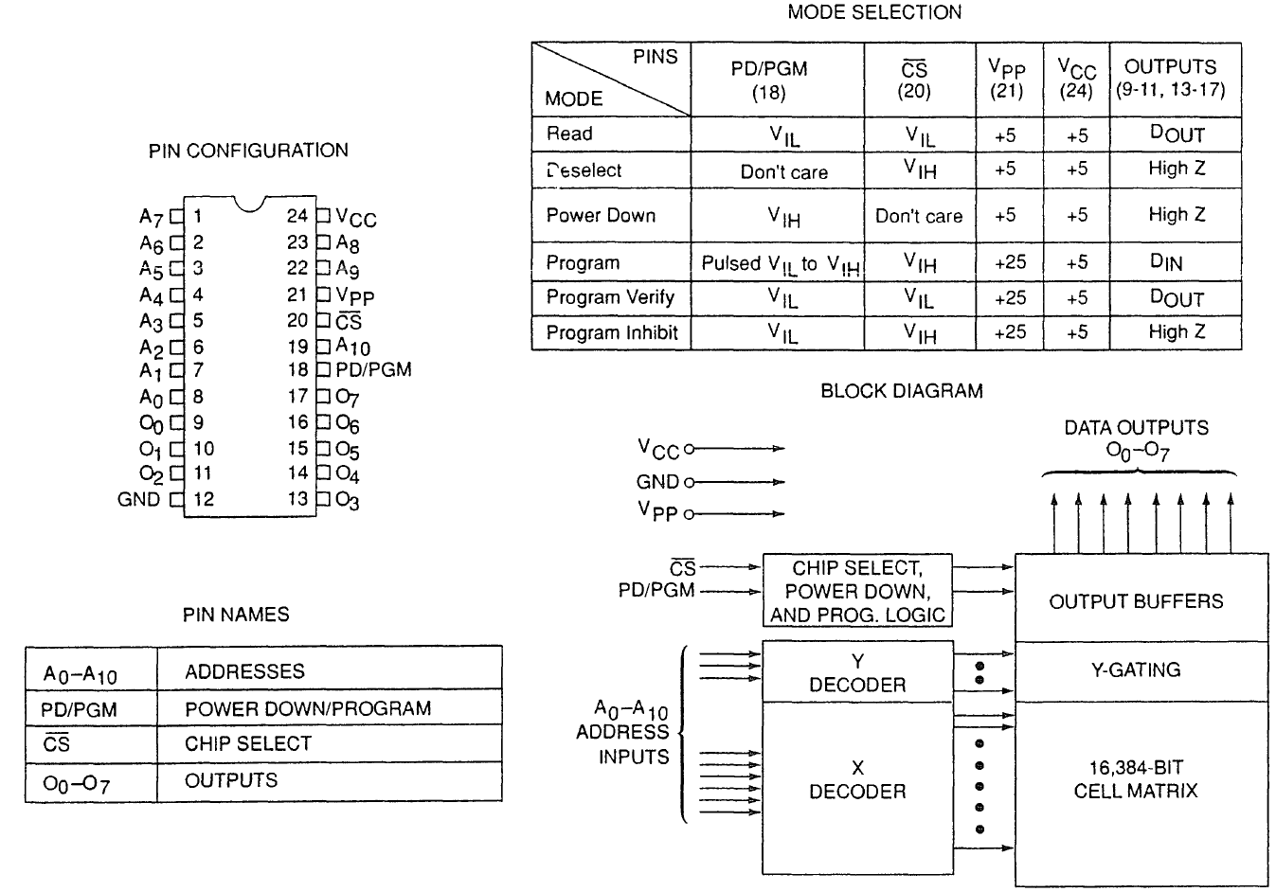
Figure 10–2 The pin-out of the 2716, 2K × 8 EPROM. (Courtesy of Intel Corporation.)

Slide 18
Figure 10–3 illustrates the timing diagram for the 2716 EPROM.
The V_{PP} pin must be placed at a logic 1 level for data to be read from the EPROM.
In some cases, the V_{PP} pin is in the same position as the WE pin on the SRAM.
This will allow a single socket to hold either
an EPROM or an SRAM.
  an example is the 27256 EPROM and 62256 SRAM, both 32K × 8 devices with the same pin-out, except for V_{PP} on the EPROM and WE on
  the SRAM.

Slide 19
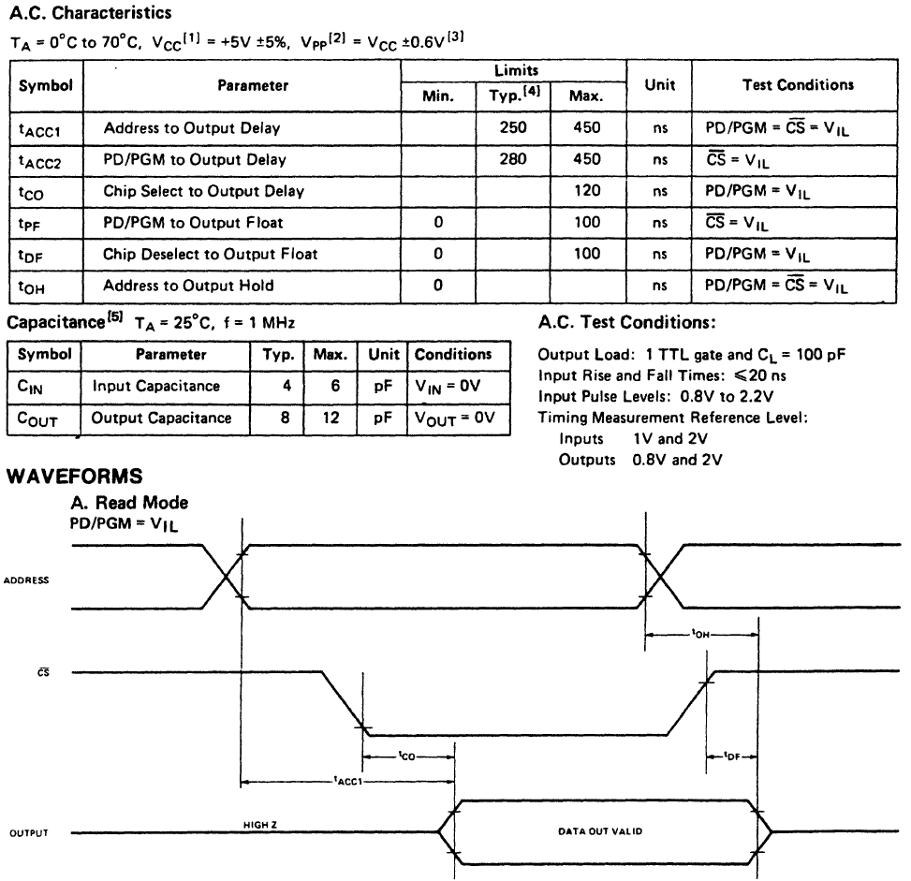
Figure 10–3 The timing diagram of AC characteristics of the 2716 EPROM.

Slide 20
The basic speed of this EPROM is 450 ns.
  recall that 8086/8088 operated with a 5 MHz clock allowed memory 460 ns to access data
This type of component requires wait states
to operate properly with 8086/8088 because of its rather long access time.
  if wait states are not desired, higher-speed EPROMs are available at additional cost
  EPROM memory is available with access times
  of as little as 100 ns
Obviously, wait states are required in modern microprocessors for any EPROM device.

Slide 21
Static RAM (SRAM) Devices
Static RAM memory devices retain data for
as long as DC power is applied.
Because no special action is required to retain data, these devices are called static memory.
  also called volatile memory because they will
  not retain data without power
The main difference between ROM and RAM is that RAM is written under normal operation, whereas ROM is programmed outside the computer and normally is only read.

Slide 22
Fig 10–4 illustrates the 4016 SRAM,
  a 2K × 8 read/write memory
This device is representative of all SRAM devices.
  except for the number of address and data connections.
The control inputs of this RAM are slightly different from those presented earlier.
  however the control pins function exactly the same as those outlined previously
Found under part numbers 2016 and 6116.

Slide 23
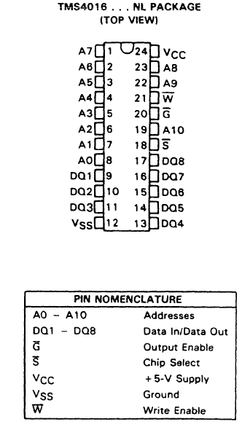
Figure 10–4 The pin-out of the TMS4016, 2K × 8 static RAM (SRAM). (Courtesy of Texas Instruments Incorporated.)
  SRAM is used when the size of the read/write memory is relatively small
  today, a small memory is less than 1M byte

Slide 24
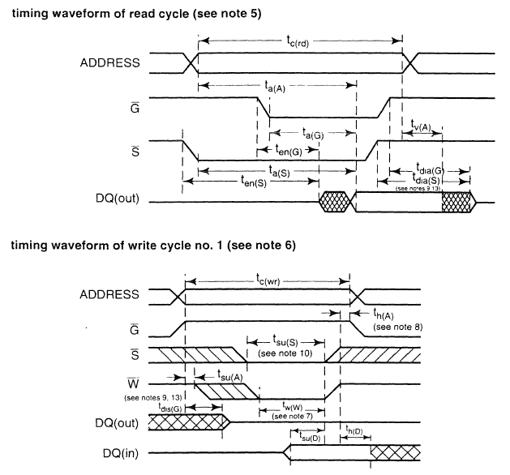
Figure 10–5 (b) The timing diagrams of the TMS4016 SRAM
the access time is t_{a(A)}
on the slowest 4016, this time is 250 ns, fast enough to connect directly to an 8088/8086 at 5 MHz, without wait states
access time must always be checked to determine compatibility of memory components

Slide 25
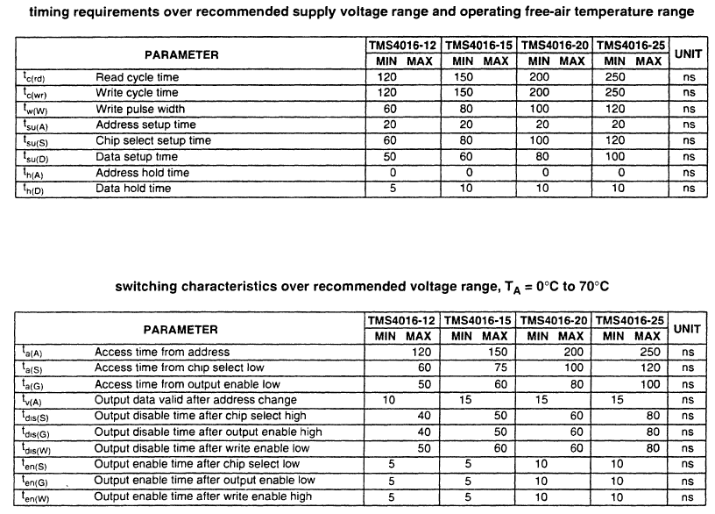
Figure 10–5 (a) The AC characteristics of the TMS4016 SRAM.

Slide 26
Figure 10–6 illustrates pin-outs of the 62256, 32K × 8 static RAM.
Packaged in a 28-pin integrated circuit
Available with access times of 120 or 150 ns.
Other common SRAM devices are
  8K × 8; 128K × 8; 256K × 8
  512K × 8; 1M × 8
Access times can be as low as 1.0 ns for SRAM used in computer cache memory.

Slide 27
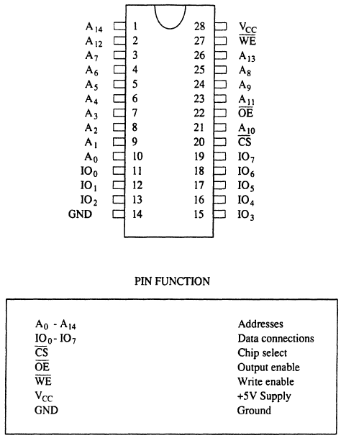
Figure 10–6 Pin diagram of the 62256, 32K × 8 static RAM.

Slide 28
Dynamic RAM (DRAM) Memory
Available up to 256M × 8 (2G bits).
DRAM is essentially the same as SRAM, except that it retains data for only 2 or 4 ms
on an integrated capacitor.
After 2 or 4 ms, the contents of the DRAM must be completely rewritten (refreshed).
  because the capacitors, which store a logic 1
  or logic 0, lose their charges

Slide 29
In DRAM, the entire contents are refreshed with 256 reads in a 2- or 4-ms interval.
  also occurs during a write, a read, or during a special refresh cycle
DRAM requires so many address pins that manufacturers multiplexed address inputs.
Figure 10–7 illustrates a 64K × 4 DRAM, the TMS4464, which stores 256K bits of data.
  note it contains only eight address inputs where
  it should contain 16—the number required to address 64K memory locations

Slide 30
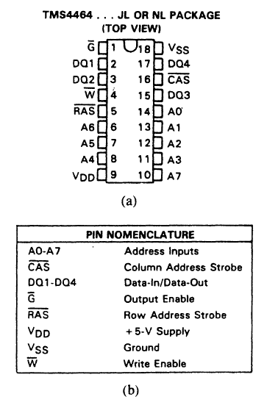
Figure 10–7 The pin-out of the TMS4464, 64K × 4 dynamic RAM (DRAM). (Courtesy of Texas Instruments Incorporated.)
  16 address bits can be forced into eight address pins in two 8-bit increments
  this requires two special pins: the column address strobe (CAS) and row address strobe (RAS)

Slide 31
First, A₀–A₇ are placed on the address pins and strobed into an internal row latch by RAS as the row address.
Next, address bits A₈-A₁₅ are placed on the same eight address inputs and strobed into an internal column latch by CAS as the column address
The 16-bit address in the internal latches addresses the contents of one of the 4-bit memory locations.
  CAS also performs chip selection input to DRAM

Slide 32
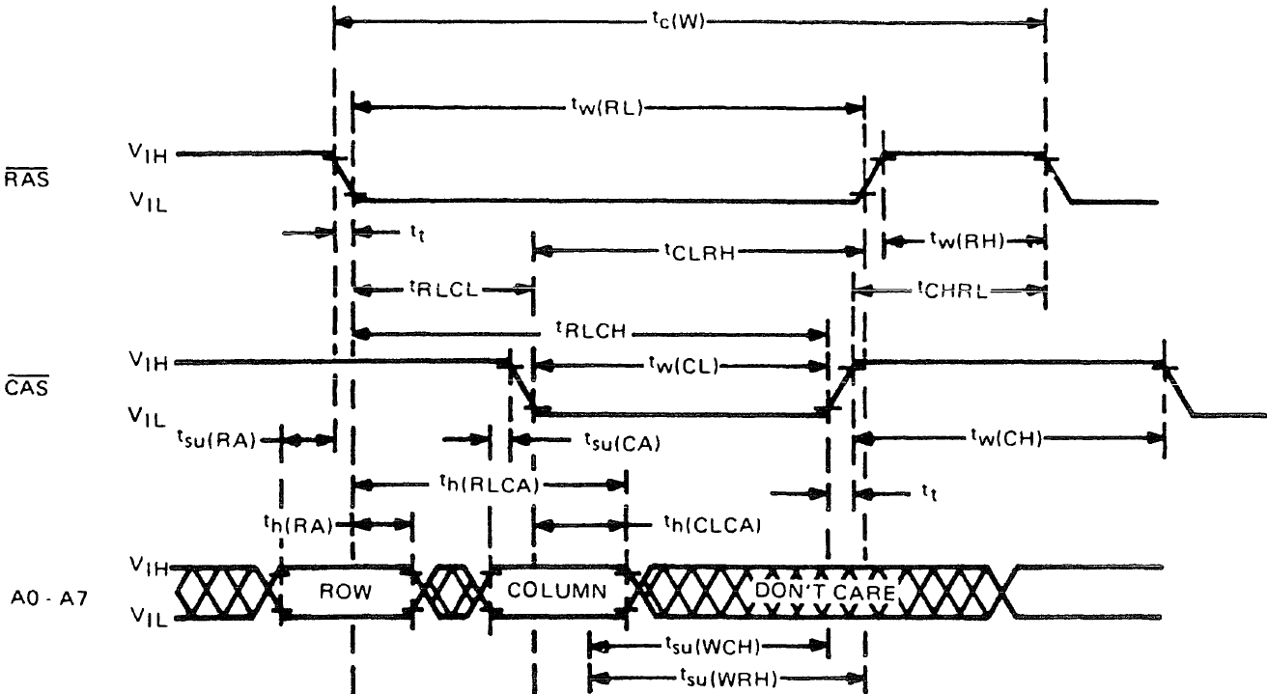
Figure 10–8 RAS, CAS and address input timing for the TMS4464 DRAM. (Courtesy of Texas Instruments Incorporated.)

Slide 33
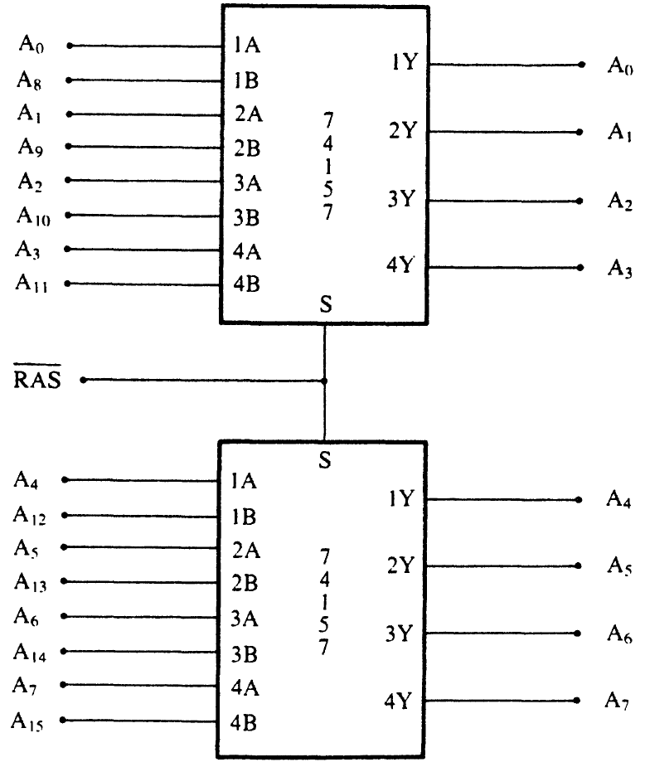
Figure 10–9 Address multiplexer for the TMS4464 DRAM.
  multiplexers used to strobe column and row addresses into the address pins on a pair of TMS4464 DRAMs.
  the RAS signal not only strobes the row address into the DRAMs, but it also selects which part of the address is applied to the address inputs.

Slide 34
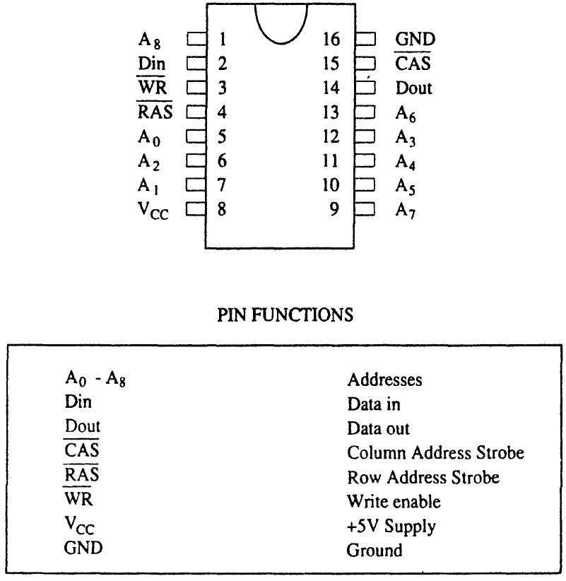
Figure 10–10 The 41256 dynamic RAM organized as a 256K × 1 memory device.
  requires as little as 70 ns to access data

Slide 35
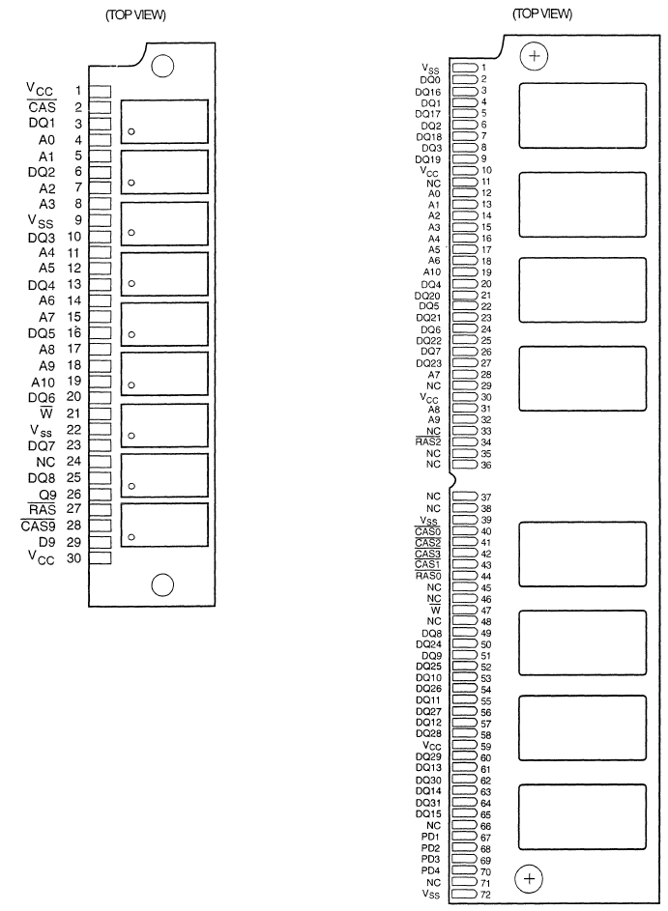
Figure 10–11 The pin-outs of the 30-pin and 72-pin SIMM. (a) A 30-pin SIMM organized as 4M × 9 and (b) a 72-pin SIMM organized as 4M × 36.

Slide 36
Pentium–Pentium 4 microprocessors have a 64-bit wide data bus, which precludes use of the 8-bit-wide SIMMs described here.
  72-pin SIMMs are cumbersome as they must be paired to obtain a 64-bit-wide data connection
64-bit-wide DIMMs (Dual In-line Memory Modules) have become the standard.
The memory on these modules is organized as 64 bits wide.
Common sizes available are from 16M bytes (2M × 64) to 1G bytes (128M × 64).

Slide 37
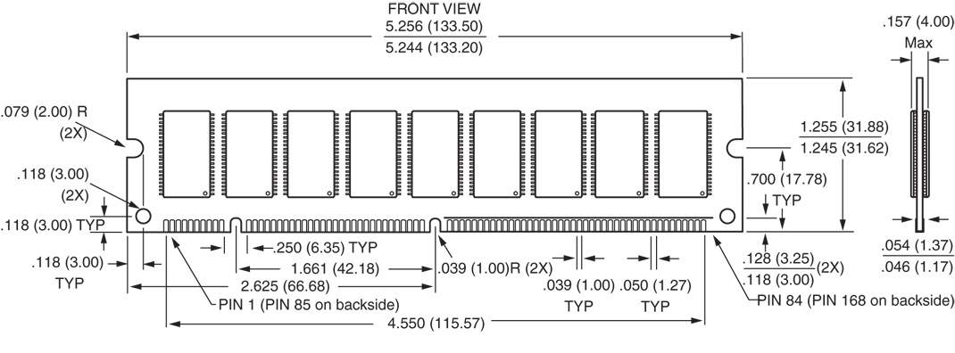
Figure 10–12 The pin-out of a 168-pin DIMM.
The DIMM module is available in DRAM, EDO, SDRAM, and DDR (double-data rate) forms, with or without an EPROM.
The EPROM provides information to the system on the size and the speed of the memory device for plug-and-play applications.

Slide 38
Another type is the RIMM memory module from RAMBUS Corporation,
  this memory type has faded from the market
The latest DRAM is the DDR (double-data rate) memory device and DDR2.
  DDR transfers data at each edge of the clock, making it operate at twice the speed of SDRAM
Many wait states are still required to operate this type of memory, but it can be much faster than normal SDRAM memory, including RDRAM.

